Slide 1
2.2 The Data Smart Enterprise
Introduction to Data Management Concepts and Practices
Helen R. Tibbo
tibbo@email.unc.edu
September 8, 2016

Slide 2
What Is a “Data Smart” Enterprise?
An organization
That optimizes management and use of external data
Lifecycle Management built on use
Data Governance
Big Data
Information Retrieval
Management Information Systems
That optimizes management and use of internally generated data
Lifecycle Management built on use
Data Governance
Big Data
Information Retrieval
Management Information Systems

Slide 3
What Is a “Data Smart” Enterprise?
An organization
That collects data on its own performance
That builds a “Culture of Assessment”
That improves based on this data and self- and user-assessment
The first half of this presentation will focus on these three factors, often seen to be essential to a “learning organization.”

Slide 4
The Learning Organization
Creates a culture that encourages and supports continuous employee learning, critical thinking, and risk taking with new ideas;
Allows mistakes, and values employee contributions;
Learns from experience and experiment; and
Disseminates the new knowledge throughout the organization for incorporation into day-to-day activities.
Read more: http://www.businessdictionary.com/definition/learning-organization.html#ixzz3xViRzLJW

Slide 5
Learning Attitude
This attitude is essential if you are changing data management from departmental to a curatorial, lifecycle approach.
It is also essential to building and implementing strategic plans for data and other digital content.
Having your strategic plans and understanding your data and use of that data is essential before you purchase a management information system.

Slide 6
Continuous Commitment
“Continuous improvement requires a commitment to learning.”
“In the absence of learning, companies—and individuals—simply repeat old practices. Change remains cosmetic, and improvements are either fortuitous or short-lived.”
David A. Garvin, Building a Learning Organization.” Harvard Business Review July-August, 1993.
https://hbr.org/1993/07/building-a-learning-organization

Slide 7
25 Years On…
Oversold and over simplified?
“where people continually expand their capacity to create the results they truly desire, where new and expansive patterns of thinking are nurtured, where collective aspiration is set free, and where people are continually learning how to learn together.”
- Peter Senge, The Fifth Discipline (New York: Doubleday, 1990), p. 1.

Slide 8
Senge’s 5 Disciplines
A shared vision
Authentic and shared
“People are not playing according to the rules of the game, but feel responsible for the game.”
Mental models
The presumptions and generalizations people have which influence their actions.
Hierarchy
Openness

Slide 9
Senge’s 5 Disciplines
Personal mastery
People’s proactive learning behavior
What is important
Assessing present state
Team learning
Team members learn more from being on a team
Team members have to be open to learning from colleagues

Slide 10
Senge’s 5 Disciplines
Systems thinking
Holistic rather than fragmented thinking
Strategic thinking
This last point is particularly important for data curation.

Slide 11
Embracing Change
As well as building a culture of assessment and learning, an organization needs to become accepting of change.
Change management is a field of its own but is essential for optimizing staff involvement in organizational change.

Slide 12
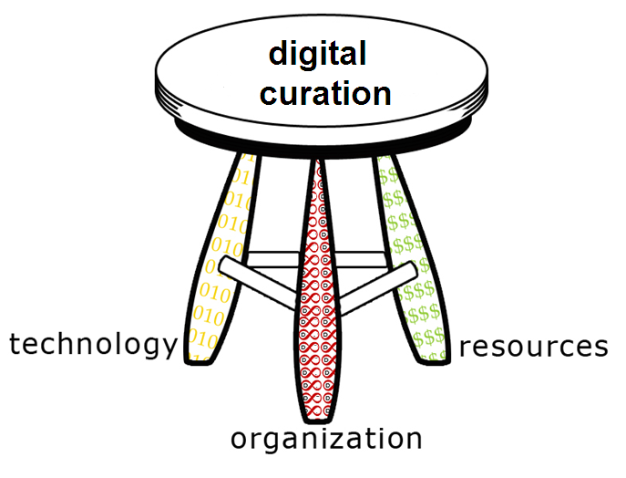
Learning, Assessment, & Strategic Planning
DPM 3-legged stool model

Slide 13
Relationship of the Legs
(how?)
(how much?)
(how?)
(how much?)
(what?)
Adapted from: Kenney and McGovern, 2003

Slide 14
Exercise 1: Learning Organization
Please break into small groups and discuss:
Is your unit/organization a “learning organization”? Why or why not?
What is the relationship of the 3 legs for your unit/organization?

Slide 15
Evaluation
“A systematic process for ascertaining whether and why an object of study meets the goals envisioned for that object.”
Gary Marchionini & Gregory Crane, “Evaluating Hypermedia and Learning: Methods and Results from the Perseus Project,” Transactions on Information Systems (TOIS) , Vol. 12 Issue 1 (January 1994): 6.

Slide 16
Assessment vs. Evaluation
Academics tend to use the term “evaluation” for this constellation of activities.
Administrators in higher education and libraries are coming to use the term “assessment” when thinking about their programs.

Slide 17
High-Level Rationale for Evaluation & Assessment
Assessment is the basis of self-understanding and improvement.
Sharing results through publication leads to profession-wide benchmarks and overall understand and improvement.
While you may not be doing this there is a literature you can read and use
You can share results within your own community
A culture of assessment can arise when fostered by administrators and managers.

Slide 18
Rationale
The ability to accurately compare and contrast program metrics with like institutions helps to
Set standards for services
Assist in planning for improvements to those functions
Support decision making
Provide rationales for resource (re)allocation.

Slide 19
The Importance of Context
When is 3/10 good performance?
Batting .300 in baseball
Score on a math test
Survival rate for a complex and experimental surgery
Survival rate for well-established surgery
Answering reference questions?
55% rule
Need to establish a baseline of acceptable, good, and excellent behavior

Slide 20
The Importance of Measurement Scale
When is a “B” acceptable?
Academic report card
Public Health score for a restaurant
Truncated scale

Slide 21
Culture of Perfection
We are a nation that focuses on #1
Winning or losing
Olympics
This attitude inhibits self-evaluation
Being an intelligence community also inhibits sharing.

Slide 22
Elements of Evaluation/Assessment
Goals and objectives of object, system, process, etc.
Evaluators.
Often other humans, i.e., staff and users of system.
Methodology.
Data.
Comparison of goals for object, event, process, etc. under study.
Conclusions.

Slide 23
Evaluation Criteria
Identifying appropriate criteria is vital for every evaluation.
These depend on:
the scope and purpose of the study
the aims of the digitisation program
the time and resources available
They need to be designed by the research team taking into account the program’s goals and users.

Slide 24
Evaluation Issues
Complex process.
Requires some level of training.
Takes time and resources.
No single golden method exists.
Multiple methods yield best view of “reality.”
Rigorous sampling is essential – study is only as good as the sample.
Quantitative / qualitative: an artificial dichotomy?
Privacy and Institutional Review Board (IRB) approval.

Slide 25
More Challenges to Evaluation/Assessment
Is empowered by standardization and generalizability.
Rigorous sampling is essential – study is only as good as the sample.
Quantitative / qualitative: an artificial dichotomy?
“Evaluation is problematic when the objects of evaluation are complex, novel, or abstract, and involve multiple, ill-defined goals.”
Gary Marchionini

Slide 26
Your Time & Effort Are Precious
Don’t explore trivial topics.
Don’t do a hasty job.
Don’t send out a survey without pre-testing.
Do work with survey design experts.
Do work with statistics consultants.
Do publish your work at least internally.

Slide 27
Building a Culture of Assessment

Slide 28
What Is a Culture of Assessment?
“An organizational environment in which decisions are based on facts, research and analysis, and where services are planned and delivered in ways that maximize positive outcomes and impacts for customers and stakeholders.”
Amos Lakos & Shelley Phipps, “Creating a Culture of Assessment,” portal: Libraries and the Academy, Vol. 4, No. 3 (2004), pp. 345–361.

Slide 29
A Culture of Assessment
A culture of assessment can guide meaningful change on a continual basis (Lakos and Phipps, 2004; Smart and St. John, 1996).
Creating this culture requires continuous learning, strategic decision making, prioritization of the allocation of scarce resources, and organizational and individual accountability (Lakos and Phipps, 2004).
An institution with a culture of assessment agrees on what is organizationally meaningful and what practices are required to fulfill its goals (Schein 1999, p. 14).

Slide 30
Common Points of Success
Organization pays attention to culture.
- Cameron & Quinn (1999)
Common definition of assessment
Clear expression of assessment expectations and the use of results
Bresciani (2009)
Assessment readiness

Slide 31
Why a Culture of Assessment?
Assessment, based on measurable, reliable, and valid data, is a pathway to sustainability.
Assessment metrics make the case for value and continuing funding.
User-based assessment metrics are an advocacy tool, drawing in the content creator the data user, and the resource allocator.

Slide 32
Five Mindsets for Building an Assessment Culture
Greg MacAyeal, “A Culture of Assessment: Five Mindsets.” College and Research Libraries News 75/6 (June 2014): 311-312.
Northwestern Univ. Music Library

Slide 33
Five Mindsets
Assessment needs to live in the ongoing, daily work of everyone
Assessment skill sets need to be cultivated in more (library) staff
Assessment implies a willingness to change
Assessment needs to align with institutional goals
Assessment reporting allows (libraries) organizations to participate in an (organization)-wide dialogue about evaluation

Slide 34
Success Factors
Assessment integrated in daily practice
Leadership
Use of data
Communication
- Abdou Ndoye and Michele A. Parker. “Creating and Sustaining a Culture of Assessment.” Planning for Higher Education 38/2 (Jan-Mar 2010): 28-39.

Slide 35
A Culture of Assessment & Evaluation
Assessment is the basis of self-understanding and improvement.
Assessment should involve users.
User-based evaluation needs to be established on concepts that are specific to your unit and the organization.
Sharing results through publication leads to profession-wide benchmarks and overall understand and improvement. This can also work within an organization.

Slide 36
User-Based Evaluation
Tells us how users view our constellation of services, service delivery, and resources, such as collections.
Is not collection-based but user-centric.
Can tell us about fulfillment of needs as well as user satisfaction.
Helps information professionals better allocate their resources for improved performance and user satisfaction.
Few user-based studies have been conducted and fewer published, especially from archives and museums, so there is much to learn.
Little comparability across studies conducted.

Slide 37
Exercise 2: Culture of Assessment
Please break into small groups and discuss:
Your unit’s status vs. the five mindsets for building an assessment culture.

Slide 38
Data Governance

Slide 39
DAMA International (https://www.dama.org/)
DAMA International is an all volunteer organization governed by an Executive Board of Directors. Directors are voted in for a 2 year term of office and may stand for re-election.
Organization started in 1988.
A non-profit, vendor-independent association where data professionals can go for help and assistance.
Goal is to provide the best practice resources such as the DMBoK and DM Dictionary of Terms in a mechanism that reaches as many DM professionals as possible.

Slide 40
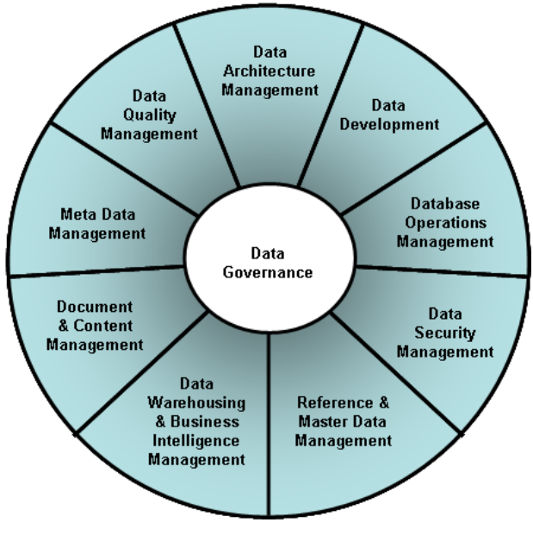
DAMA-DMBOK Functional Framework

Slide 41
DAMA-DMBOK Functional Outline
Data Governance
1.1.Data Management Planning
1.1.1. Identify Strategic Enterprise Data Needs (P)
1.1.2. Develop & Maintain the Data Strategy (P)
1.1.3. Establish the Data Management Professional Organizations (P)
1.1.4. Identify & Appoint Data Stewards (P)
1.1.5. Establish Data Governance & Stewardship Organizations (P)
1.1.6. Develop, Review & Approve Data Policies, Standards and Procedures (P)
1.1.7. Review & Approve Data Architecture (P)
1.1.8. Plan and Sponsor Data Management Projects & Services (P)
1.1.9. Estimate Data Asset Value & Associated Data Management Costs (P)

Slide 42
DAMA-DMBOK Functional Outline
1.2.Data Management Supervision & Control
1.2.1. Supervise the Data Management Professional Staff & Organizations (C)
1.2.2. Coordinate Data Governance Activities (C)
1.2.3. Manage & Resolve Data Related Issues (C)
1.2.4. Monitor & Ensure Regulatory Compliance (C)
1.2.5. Monitor Conformance with Data Policies, Standards and Architecture (C)
1.2.6. Oversee Data Management Projects & Services (C)
1.2.7. Communicate & Promote the Value of Data Assets (C)

Slide 43
DAMA DM Function Definitions
Data Governance – planning, supervision and control over data management and use
Data Architecture Management – an integral part of the enterprise architecture
Data Development – analysis, design, building, testing, deployment and maintenance
Database Operations Management – support for structured physical data assets
Data Security Management – ensuring privacy, confidentiality and appropriate access
Reference & Master Data Management – managing golden versions and replicas

Slide 44
DAMA DM Function Definitions
Data Warehousing & Business Intelligence Management – enabling access to decision support data for reporting and analysis
Document & Content Management – storing, protecting, indexing and enabling access to data found in unstructured sources electronic files and physical records)
Meta Data Management – integrating, controlling and delivering meta data
Data Quality Management – defining, monitoring and improving data quality

Slide 45
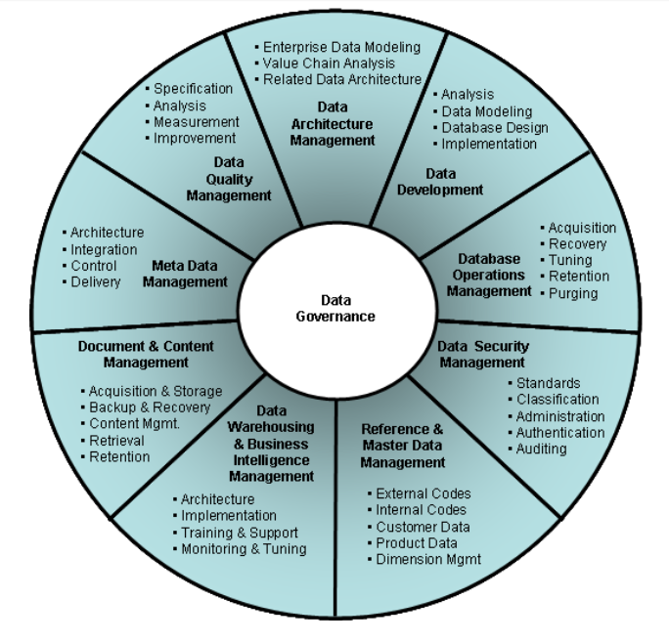

Slide 46
More Detailed Definitions
Data Governance
The exercise of authority, control and shared decision-making (planning, monitoring and enforcement) over the management of data assets. Data Governance is high-level planning and control over data management.
Data Architecture Management
The development and maintenance of enterprise data architecture, within the context of all enterprise architecture, and its connection with the application system solutions and projects that implement enterprise architecture.

Slide 47
More Detailed Definitions
Data Development
The data-focused activities within the system development lifecycle (SDLC), including data modeling and data requirements analysis, design, implementation and maintenance of databases data-related solution components.
Database Operations Management
Planning, control and support for structured data assets across the data lifecycle, from creation and acquisition through archival and purge.
Data Security Management
Planning, implementation and control activities to ensure privacy and confidentiality and to prevent unauthorized and inappropriate data access, creation or change.

Slide 48
More Detailed Definitions
Reference & Master Data Management
Planning, implementation, and control activities to ensure consistency of contextual data values with a “golden version” of these data values.
Data Warehousing & Business Intelligence Management
Planning, implementation and control processes to provide decision support data and support knowledge workers engaged in reporting, query and analysis.

Slide 49
More Detailed Definitions
Document & Content Management
Planning, implementation and control activities to store, protect and access data found within electronic files and physical records (including text, graphics, image, audio, video)
Meta Data Management
Planning, implementation and control activities to enable easy access to high quality, integrated meta data.
Data Quality Management
Planning, implementation and control activities that apply quality management techniques to measure, assess, improve and ensure the fitness of data for use.

Slide 50
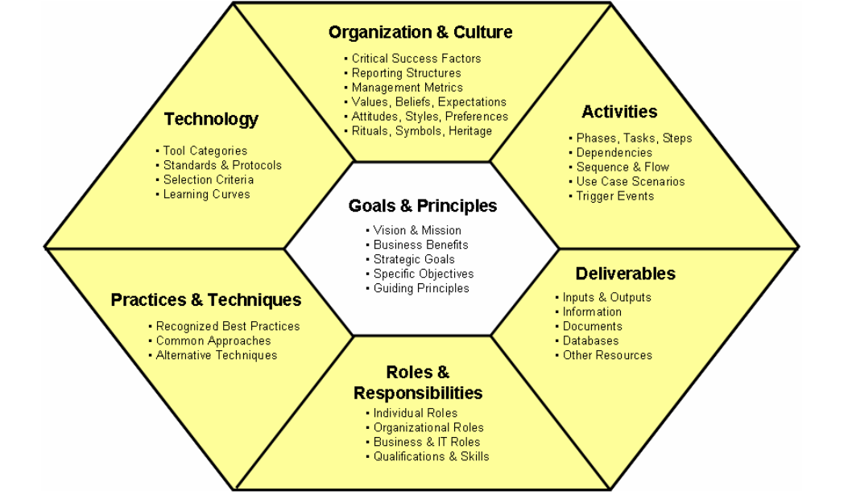
Environmental Elements

Slide 51
Environmental Elements
Our structure provides for lists of basic elements (Goals & Principles, Activities, Deliverables, Roles & Responsibilities,) before addressing and elaborating on less structured topics (Practices and Procedures, Technology, Organization & Culture).

Slide 52
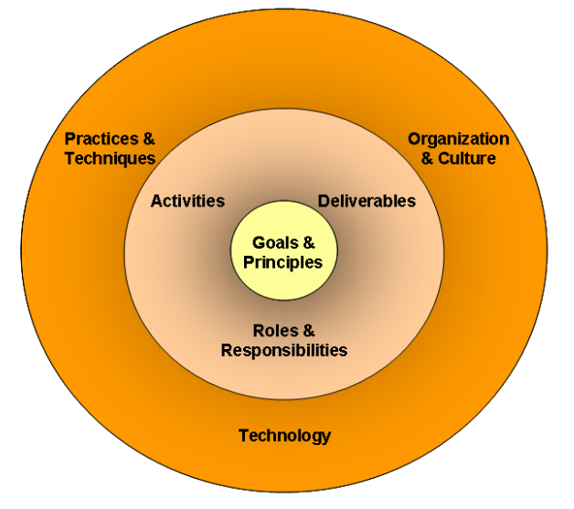
Another way to look at the 7 elements
DPM would insert “resources” in this outer ring

Slide 53
Basic Environmental Elements
Goals & Principles
The directional business goals of each function and the fundamental principles that guide performance of each function.
Activities
Each function is further decomposed into lower level activities. Some activities are grouped into sub-functions. Activities can be further decomposed into tasks and steps.

Slide 54
Basic Environmental Elements
Deliverables
The information and physical databases and documents created as interim and final outputs of each function. Some are considered essential, some are generally recommended, and others are optional depending on circumstances.
Roles and Responsibilities
The business and IT roles involved in performing and supervising the function and the specific responsibilities of each role in that function. Many roles will participate in multiple functions.

Slide 55
Supporting Environmental Elements
Practices & Procedures
Common and popular methods and techniques used to perform the processes and produce the deliverables. May also include common conventions, best practice recommendations and alternative approaches without elaboration.
Technology
Categories of supporting technology (primarily software tools), standards and protocols, product selection criteria and common learning curves. In accordance with DAMA policies, specific vendors or products should not be mentioned.

Slide 56
Organization and Culture These issues might include:
Management Metrics – measures of size, effort, time, cost, quality, effectiveness, productivity, success and business value
Critical Success Factors
Reporting Structures
Contracting Strategies
Budgeting and Related Resource Allocation Issues
Teamwork and Group Dynamics
Authority & Empowerment
Shared Values & Beliefs
Expectations & Attitudes
Personal Style & Preference Differences
Cultural Rites, Rituals and Symbols
Organizational Heritage
Change Management Recommendations

Slide 57
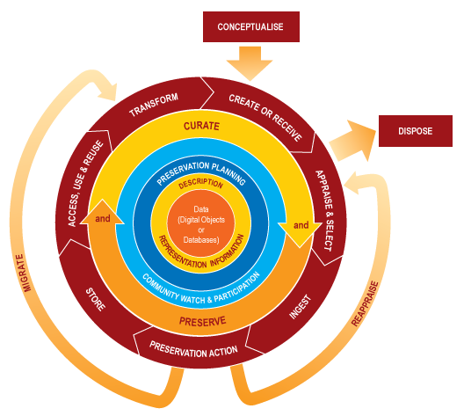
DCC Curation Lifecycle Model
Higgins, S. (2008). “The DCC Curation Lifecycle Model.” International Journal of Digital Curation, 3(1), 134–140. doi:10.2218/ijdc.v3i1.48 & http://www.dcc.ac.uk/resources/curation-lifecycle-model

Slide 58
Exercise 3: Reconciling DMBOK Model and Data Curation Model
Break into pairs or small groups and discuss how the DMBOK model can be related to the DCC’s Data Curation Model.
Groups will draw their diagrams on board.

Slide 59
Stanford’s Data Governance Maturity Model

Slide 60
Stanford’s DG Definition
“the formalization of behavior around the definition, production and usage of data to manage risk and improve the quality and usability of selected data.”
Matt Hoying quoting Robert Seiner http://web.stanford.edu/dept/pres-provost/cgi-bin/dg/wordpress/wp-content/uploads/2011/11/DG-Pres002.pdf

Slide 61
Stanford’s DG Components
People
Authority
Policy
Policy Management
Communication
Technology
Data Policies & Rules
Compliance Monitoring
Issue Resolution
Decision Rights
Performance Management
Information Flow Management
Data Stewardship
Business Role
Collaboration
Accountability
Cultural Attitude
Policy Orchestration
Modeling
Master Data
Data Quality Management

Slide 62
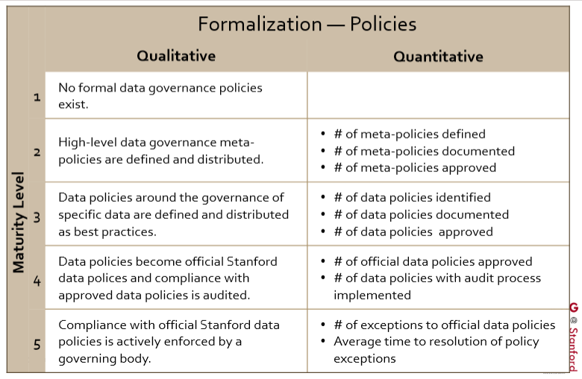
Stanford’s DG Measures

Slide 63
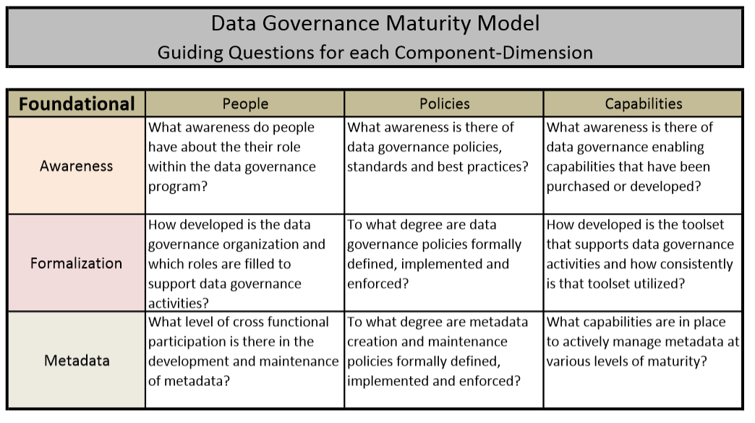
Stanford’s DG Maturity Model (https://web.stanford.edu/dept/pres-provost/irds/dg/files/StanfordDataGovernanceMaturityModel.pdf)

Slide 64
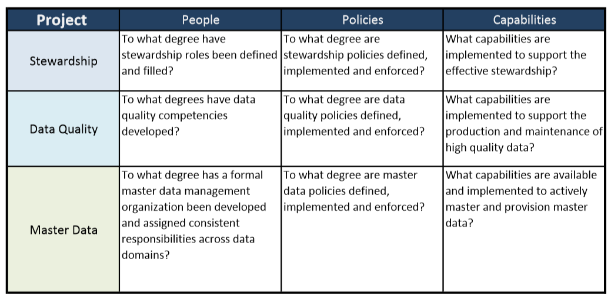
Stanford’s DGMM - Projects

Slide 65
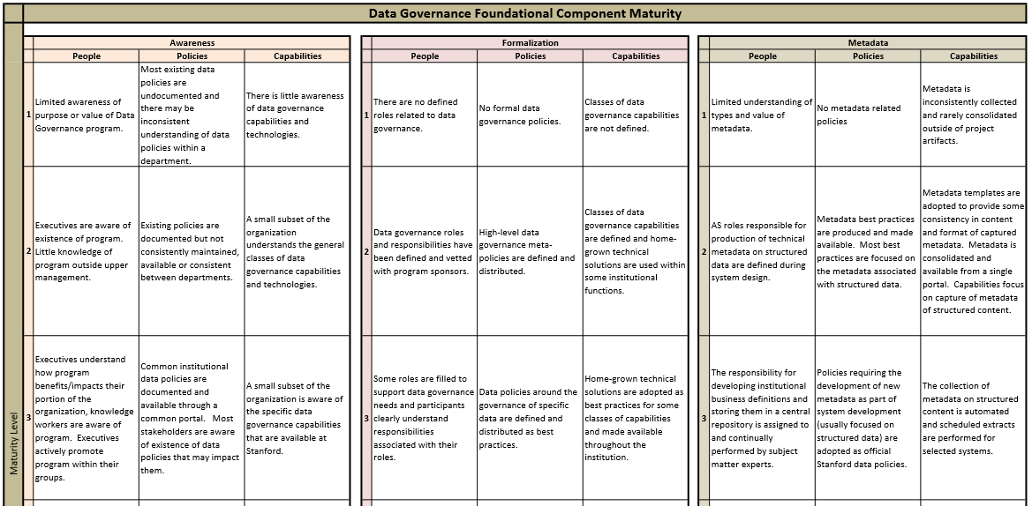
Stanford’s DGMM – Foundational Components

Slide 66
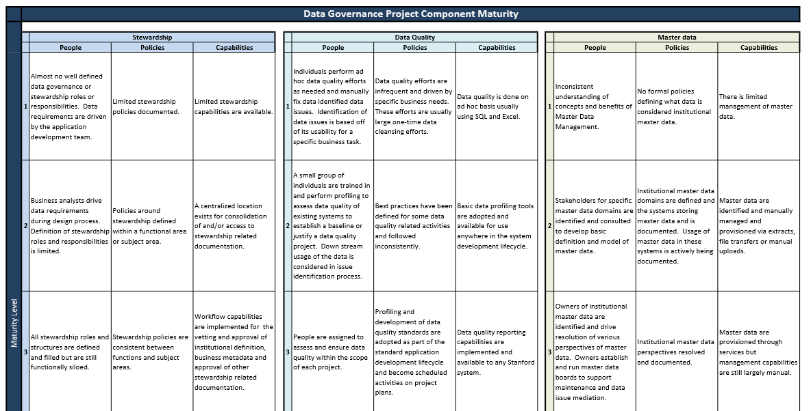
Stanford’s DGMM – Project Components

Slide 67
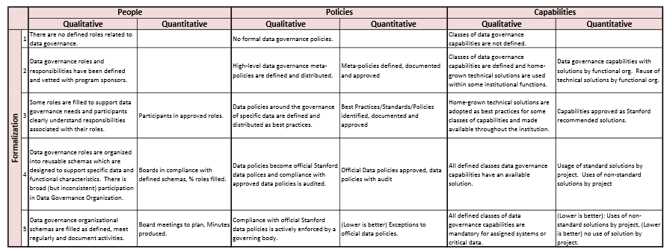
Formalization

Slide 68
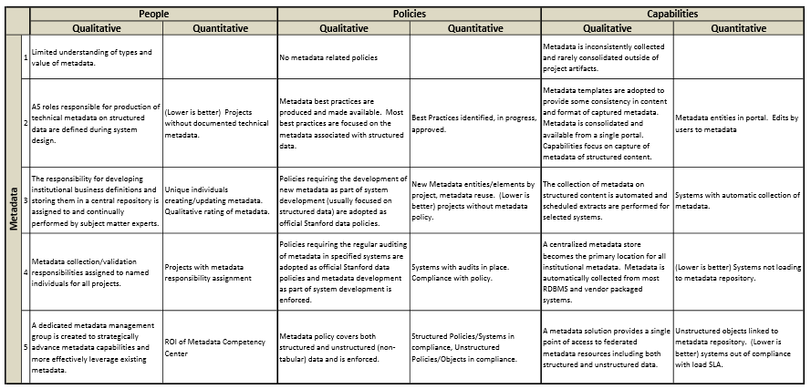
Metadata

Slide 69
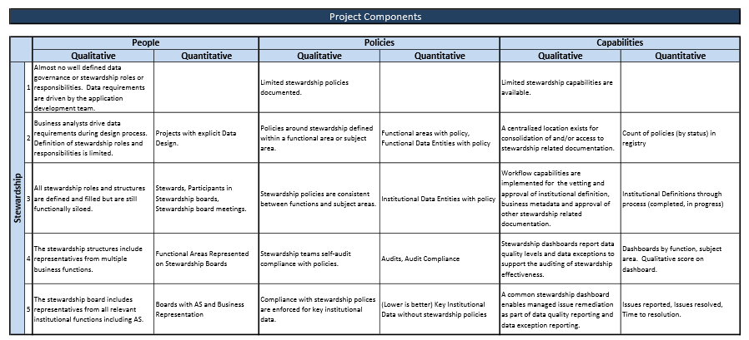
Stewardship

Slide 70
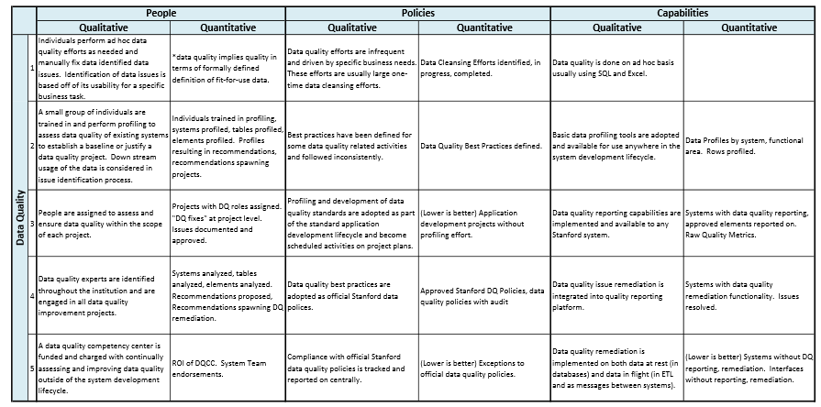
Data Quality

Slide 71
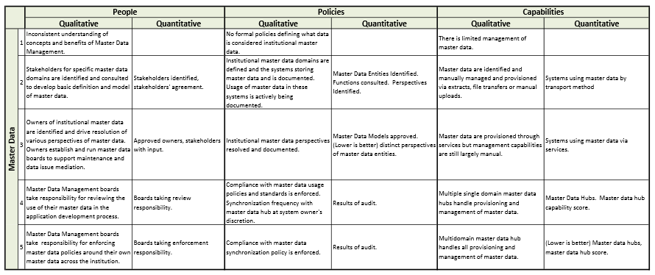
Master Data

Slide 72
DPM’s Five Organizational Stages
Acknowledge: accepting digital curation as a shared concern
Act: initiating digital preservation projects
Consolidate: segueing from projects to programs
Institutionalize: incorporating external and rationalizing programs
Externalize: embracing collaboration and interdependency
Source: Kenney and McGovern, 2003

Slide 73
Exercise 4: Data Governance
Please break into groups and consider the following:
What does the governance model look like in your organization? Provide as much detail as possible.
Try to draw a diagram of the model.
Where does your unit fit into this model?

Slide 74
What Data Management Is Doing

Slide 75
Data Lifecycle and Initiatives
UNCLASSIFIED//FOUO
The six phases of the Mission Data Lifecycle provided below illustrate a high level overview of the various stages involved in the management and use of data. The mission data lifecycle supports and contributes to the cycle of: Tasking, Collection, Processing, Exploitation, and Dissemination.
The following four initiatives below span the entire Mission Data Lifecycle
10
Data Disposal
9
Data Archival
Extract Transform Load (ETL)/
Data Migration
Retain or
Retire
Plan &Task
5
1
Data Governance
Tasking
Dissemination
Collection
2
Architecture and Design
Analyze &
Exploit
Processing
Acquire
& Access
Data Storage
Exploitation
3
Data Administration
Knowledge Discovery
6
Quality Assurance
4
8
Discover &
Share
Authorize &
Process
7
Data Sharing
UNCLASSIFIED//FOUO

Slide 76
leading practices for Data Archiving
Implemented:
Recommended:
Make archive structurally safe⁴ | 1 | Use long-lasting media; update regularly¹⁸ | 2 | Maintain data redundancy¹⁸ | 1
Archive data in a facility that is structurally sound and free from the risk of flood and fire⁴ |  | Archive data on media that will last as long as your retention policy, regularly update media between two to five years to maintain integrity of data and keep it accessible¹⁸ |  | Keep data safe from failures by maintaining redundancy in your archive¹⁸
Security-scan before archiving and restoral¹⁸ | 1 | Regularly check data for usability⁴ | 2
Scan all files for viruses and malware before archiving, restore to an isolated environment and re-scan before moving to production¹⁸ |  | Restore archived data at regular intervals and check for usability, raise and resolve any integrity or usability concerns⁴
1
Initial
2
Managed
3
Defined
4
Measured
5
Optimized

Slide 77
Approach
The team presents data management leading practices, prioritized left to right, for each of the 10 Data Lifecycle Initiatives. We separate Implemented practices from Recommended practices. The associated Data Management Maturity (DMM) level is identified for all practices. Necessary details and an action for Data Management Staff are included for the Recommended practices.
leading practices for
Data Governance
Data LifecycleInitiative
DMM Level contributed to by accomplishment
Implemented:
Recommended:
Engage industry on leading practices and lessons learned | 5
Keep workforce communications open | 2
Communicate policies, standards, and processes, adjust with feedback
Necessary Details
Implemented Leading Practice
Recommended Leading Practice
DMM Key
1
Initial
2
Managed
3
Defined
4
Measured
5
Optimized

Slide 78
Key Takeaways
The client has already successfully implemented several leading practices across the 10 Data Lifecycle Initiatives and is in the process of implementing others
The client should prioritize four leading practices and associated major actions for Data Management Staff that may require significant effort:
The client should prioritize four quickly achievable leading practices and associated minor actions for Data Management Staff:
Data Migration |  | Architecture, Analysis, and Design |  | Data Governance |  | Quality Assurance
Plan for data migration⁹ | 2 | Support data management processes³ | 2 | Publish an enterprise-wide policy directive³ | 3 | Have a data quality strategy² | 3
Data Migration |  | Quality Assurance |  | Data Governance
Plan for quality before collection⁴ | 2 | Make business users data stewards¹³ | 2 | Keep workforce communications open | 2 | Centralize resources for the workforce⁴ | 3
1
Initial
2
Managed
3
Defined
4
Measured
5
Optimized

Slide 79
leading practices for Data Governance
Implemented:
Recommended:
Monitor and ensure regulatory compliance¹ | 1
Monitor conformance with data policies and standards¹ | 1
Establish governance body and working groups^{2,3} | 2
Provide a strategic roadmap and a data management framework^{3,4} | 2
Define standard terms and roles and responsibilities^{3,5} | 2
Acquire, train, and retain data managers³ | 2
Maintain corporate view of data and its value^{1,3} | 3
Implement data management planning⁵ | 2
Engage industry on leading practices and lessons learned³ | 5
Monitor secondary use of your data⁴ | 1 | Manage acquired data on behalf of owners⁴ | 1 | Revisit data management plans throughout projects⁵ | 2
Keep workforce communications open | 2 | Publish an enterprise-wide policy directive³ | 3 | Centralize resources for the workforce⁴ | 3
Communicate policies, standards, and processes, adjust with feedback² |  | Identify regulatory compliance mandates, define data storage, protection, auditing, planning, standards, sharing, archiving, and retention policies |  | Make communications, directives, standards, guides, and tools accessible from one location
Model data and develop standards¹ | 3 | Introduce and track performance measures³ | 4 | Implement and sustain performance improvement program³ | 5
Build taxonomy, provide definitions; leverage existing standards and define models, format, syntax, controlled values and validation rules; provide examples |  | Report via scorecards and management dashboards
Key Takeaway
1
Initial
2
Managed
3
Defined
4
Measured
5
Optimized

Slide 80
leading practices for Architecture, Analysis, and Design
Implemented:
Recommended:
Support data management processes³ | 2 | Document design with transparency | 3 | Follow architectural standards² | 3
Identify, acquire or build, and deploy appropriate tools and platforms for data storage, planning, inventory and datacasting, modeling and profiling, cleaning and enrichment, and analytics and knowledge extraction |  | Provide specifications with traceability from creation through consumption² |  | Consider Enterprise Architectural Frameworks, such as Zachman, TOGAF, FEA, and Gartner, that address system complexity and promote business alignment⁶
Create and maintain test data¹ | 3
Gather valid and invalid/illegal data with variety and in large volumes⁷
1
Initial
2
Managed
3
Defined
4
Measured
5
Optimized

Slide 81
leading practices for Data Storage
Implemented:
Recommended:
Use a suitable common repository⁵ | 2 | Classify information confidentiality¹ | 1 | Keep names intuitive and descriptive⁵ | 1
Share a user-friendly repository that allows depositing data, versioning/back-up, browsing, search/discovery, controlled access, building equity, archiving and citations; may also offer rating and providing feedback, cataloging, curation, and share requests; consider cell-level access control^{4,5,8} |  | Mark and portion-mark information with Controlled Unclassified Information (CUI) classifications |  | Make names of folders, files, tables, fields, and variables intuitive and descriptive
 |  | Keep structures well-organized⁴ | 1 | Provide informative documentation⁵ | 1
 |  | Make structures of folders, files, data model, and content logical and organized |  | Include a data management plan or a read-me file that describes the project, the spatial and temporal extent, the data/content, the sources, the methodology, the outliers, the estimates, the data quality measures, the POCs, and future plans⁵
Meet data and quality standards⁵ | 3 | Archive inactive but valuable data⁴ | 2
Adhere to data standards and ensure quality control; provide required and suggested metadata¹ |  | Move master files of inactive data, that has been identified for long-term preservation, to archive⁴
1
Initial
2
Managed
3
Defined
4
Measured
5
Optimized

Slide 82
leading practices for Extract Transform Load (ETL)/ Data Migration
Implemented:
Recommended:
Cite the data source, data distributor, and copyright holder⁴ | 1
Plan for quality before collection⁴ | 2 | Collect with quality⁵ | 1
Identify and document data quality measures before data collection, consider gathering parameters that widen the applicability of your data⁴ |  | Maintain consistent data typing, separate values from annotations, store with appropriate precision, use consistent codes and appropriate delimiters, provide required and suggested metadata, double-check⁵
Plan for data migration⁹ | 2 | Use migration to clean data¹⁰ | 3
Describe compatibility of data being integrated, compatibility of source and destination environments, migration architecture, integration method, related workforce communication, pre and post validation tests, closeout and knowledge transfer activities⁹ |  | Take the opportunity and clean data being migrated to enforce data and quality standards; alternatively, consider migrating data as-is and enabling schema-on-read options at the time of knowledge extraction¹¹
Key Takeaway
1
Initial
2
Managed
3
Defined
4
Measured
5
Optimized

Slide 83
leading practices for Quality Assurance
Implemented:
Recommended:
Have a data quality strategy² | 3 | Make business users data stewards¹³ | 2 | Perform data quality assessments² | 3
Develop rules that promote data completeness, uniqueness, timeliness, validity, accuracy, and consistency (consider other dimensions), define clear roles and responsibilities for quality, develop quality control and assurance procedures^{4,5,12} |  | Empower business users with data steward responsibilities to promote integrity and quality of data under their stewardship |  | Profile data and assess quality against data standards and quality rules; mark data with quality control flags to distinguish between “good” and “bad” data⁵
Clean data to improve quality¹⁴ | 3 | Implement Master Data Management (MDM) solutions¹ | 4 | Enrich data via data integration¹⁵ | 5
Identify and document transformations and mappings required to improve “bad” data, clean using an ETL/Data Migration workflow¹⁴ |  | De-duplicate data via object linkage or entity resolution; build a data quality firewall around high quality data^{13,15} |  | Fuse related data together to capture a unified truth and enhance overall data value
 |  |  |  | Go from databases to a knowledge-base¹⁶ | 5
 |  |  |  | Extract and gather knowledge from available data via information extraction
Key Takeaway
1
Initial
2
Managed
3
Defined
4
Measured
5
Optimized

Slide 84
leading practices for Knowledge Discovery
Implemented:
Recommended:
Implement Business Intelligence (BI) tools and user interfaces¹ | 2
Improve methodologies and tools with deployment feedback | 2
Have a knowledge discovery strategy¹⁷ | 3 | Ensure steps are repeatable and results reproducible⁵ | 1 | Improve business and data understanding¹⁷ | 2
Define what metrics drive the organization, metrics maturity goals and roadmap, and iterative/agile analytic processes that can deliver on identified metrics, identify underlying architecture that supports agile methodologies and integrates well to limit the variety of technical skills needed¹⁷ |  | Ensure data preparation, modeling/mining, and interpretation/evaluation are documented and reproducible |  | Develop senior analysts that are well-versed in functional aspects of the organization and truly understand the data¹⁷
Introduce self-service BI solutions¹⁷ | 4
Democratize knowledge discovery and enable non-technical workforce to mine and interpret data using self-service BI solutions and without any assistance from data scientists
1
Initial
2
Managed
3
Defined
4
Measured
5
Optimized

Slide 85
leading practices for Data Sharing
Implemented:
Recommended:
Develop and implement metadata standards⁵ | 3
Make data available in stable file formats⁵ | 1 | Check for print and web accessibility⁵ | 1 | Make data freely available internally⁴ | 2
Provide data in stable and open file formats that can be read well into the future and do not require proprietary licenses, e.g. .txt, .csv, .tiff, .pdf/a, .zip; if a particular configuration is required to work with the data, specify so in metadata⁵ |  | Provide text alternatives to non-text content, make content readable/audible, understandable, operable in predictable ways, and compatible with assistive technologies; do not use content that causes seizures⁵ |  | Enable informal sharing, access and use via user interfaces, web portals, and web services; provide subsets of data if needed⁵
Provide a citation for your dataset⁵ | 1 | Maintain and share a data inventory⁴ | 4
Describe how to properly cite your data, include Digital Object Identifier (DOI), title, publication date, publisher, URL and contributors⁵ |  | Promote data to many users by developing an inventory and making it available to desired users; prioritize higher-value data; consider other datacasting services such as RSS and GeoRSS⁵
1
Initial
2
Managed
3
Defined
4
Measured
5
Optimized

Slide 86
leading practices for Data Archiving
Implemented:
Recommended:
Make archive structurally safe⁴ | 1 | Use long-lasting media; update regularly¹⁸ | 2 | Maintain data redundancy¹⁸ | 1
Archive data in a facility that is structurally sound and free from the risk of flood and fire⁴ |  | Archive data on media that will last as long as your retention policy, regularly update media between two to five years to maintain integrity of data and keep it accessible¹⁸ |  | Keep data safe from failures by maintaining redundancy in your archive¹⁸
Security-scan before archiving and restoral¹⁸ | 1 | Regularly check data for usability⁴ | 2
Scan all files for viruses and malware before archiving, restore to an isolated environment and re-scan before moving to production¹⁸ |  | Restore archived data at regular intervals and check for usability, raise and resolve any integrity or usability concerns⁴
1
Initial
2
Managed
3
Defined
4
Measured
5
Optimized

Slide 87
leading practices for Data Disposal
Implemented:
Recommended:
Clear media by overwriting data¹⁹ | 1 | Purge damaged or large magnetic media¹⁹ | 2 | Destroy media and make retrieval infeasible¹⁹ | 1
Overwrite user-addressable storage space on the media with non-sensitive data (this method cannot be used on damaged or not rewritable media); verify data cannot be retrieved¹⁹ |  | Use degaussing to sanitize damaged, not rewritable, or exceptionally large magnetic storage media; verify data cannot be retrieved¹⁹ |  | Disintegrate, pulverize, melt, or incinerate media using a secure destruction facility^{4,19}
1
Initial
2
Managed
3
Defined
4
Measured
5
Optimized

Slide 88
Exercise 5: Moving Forward
Open discussion:
What is your reaction to the DMBOK in relation to the other models?
What should be at the core of these models?
How is your unit participating?
What are the strengths? Weaknesses? At this point?
What next?

